Slide 1

Basic Threads
Creating Threads
Controlling Threads
Stopping a Thread
Notes:
How to start a thread
The thread manager object
Sleeping
IntPair example
Guards
Mention old form

Slide 2

See Also
https://docs.oracle.com/javase/tutorial/essential/concurrency/
http://www.tutorialspoint.com/java/java_multithreading.htm
Notes:
Here are some additional tutorials and videos to accompany this lesson.
<PAUSE>

Slide 3
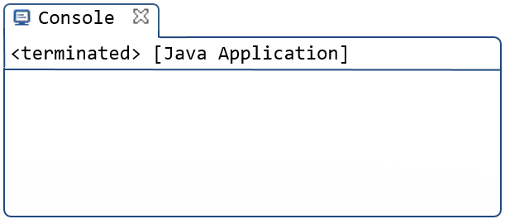
Point of Entry
The “main” method is the entry point of your application
An object’s “run” method is the entry point of a thread
public class Tinker {
public static void main(String[] args) {
System.out.println("Starting");
Speaker sp = new Speaker();
sp.run();
System.out.println("Ending");
}
}
public class Speaker {
public void run() {
System.out.println("Run starting");
Thread.sleep(5000);
System.out.println("Run ending");
}
}
Starting
Run starting
Run ending
Ending
Streams of bytes … two ways (into your program and out of your program)
Disks, consoles, sockets, keyboards, printers
Know how to talk streams and you can talk to anything
Initialization (constructor) is different. Use is the same.
Notes:
“main” is the entry point for your application
@2 For a thread you need a regular old object that has a “run” method.
@3 Here is a class “Speaker” … @4 with a “run” method
We’ll give it a couple of print functions at the beginning and end like this @5
@6 Over in our main we’ll add print statements at the top and bottom too
Remember how to create an object? Using new. Like this @7.
Now we have an object on the heap. The object is of type “Speaker” and we have a local variable on our stack called “sp” that points to it … or references it … however you prefer. Is it coming back?
We can call the “run” method on the object like this @9
Then lets put in a delay of 5000 milliseconds (5 seconds) with the sleep function. @10
We haven’t talked about “sleep” yet. We will shortly. Just know that it puts the calling thread to sleep for the requested amount of time.
The output looks like this:
(pause before “Run ending”)
But that’s nothing out of the ordinary that’s just one thread calling a function. You’ve been doing that already.

Slide 4


Point of Entry
public class Tinker {
public static void main(String[] args) {
System.out.println("Starting");
Speaker sp = new Speaker();
sp.run();
System.out.println("Ending");
}
}
public class Speaker {
public void run() {
System.out.println("Run starting");
Thread.sleep(5000);
System.out.println("Run ending");
}
}
Streams of bytes … two ways (into your program and out of your program)
Disks, consoles, sockets, keyboards, printers
Know how to talk streams and you can talk to anything
Initialization (constructor) is different. Use is the same.
Notes:
@1 What we need is some magic here instead of “run”. We do want to run the method, but we want to start a new thread and have it go run that method while we carry on.
@2 The original thread continues on through the function. A new thread starts up and calls the target function. We have “forked” the CPU’s flow into two simultaneous directions.

Slide 5

Runnable
class Speaker implements Runnable {
@Override
public void run() {
System.out.println("Run starting");
Thread.sleep(5000);
System.out.println("Run ending");
}
}
Streams of bytes … two ways (into your program and out of your program)
Disks, consoles, sockets, keyboards, printers
Know how to talk streams and you can talk to anything
Initialization (constructor) is different. Use is the same.
Notes:
But first it isn’t enough to just provide a “run” method. You have to “promise” the compiler that you are. You have to implement the “Runnable” interface, which has just one public method … “run” that returns nothing and throws no exception.
Now the compiler can check you and complain if you don’t.
@1 And add the “@Override” so the compiler can double check that you spelled it right.
We haven’t done anything magical yet. This is still a plain old java object that just promises it has a run method. Nothing “threading” about any of this yet.

Slide 6
Thread Manager
Speaker
public static void main(String[] args) {
System.out.println("Starting");
Speaker sp = new Speaker();
Thread mgr = new Thread(sp);
mgr.start();
System.out.println("Ending");
}
Thread
Return address
Speaker sp
Thread mgr
Starting
Ending
Run starting
Run ending
Streams of bytes … two ways (into your program and out of your program)
Disks, consoles, sockets, keyboards, printers
Know how to talk streams and you can talk to anything
Initialization (constructor) is different. Use is the same.
Notes:
Remember that a thread has a chunk of information about it … where its stack pointer and program counter are … etc.
When you start a new thread then the OS creates a new data structure to go with it. You use this data structure to get information about the thread – what line of code it is on, what it’s current call stack looks like, etc.
You also use it to control the thread. For instance you tell the OS to start or stop or pause or resume the thread by using its data structure.
You create an object that encapsulates this operating system data structure. The object is called thread, but should be called “Thread Manager” or “Thread Data”.
@1 You create the manager object and pass in a pointer to the destination object … the object that has your desired “run” method.
All you have done is create one object of type “thread” pointing to another object of type “sp”. You haven’t done any magic at all. The name is misleading. You have NOT created a new thread even though you did “new Thread”. You have created a new thread manager … an object to control the thread and read its data structure.
@2 On the stack you have two pointers “sp” and “mgr”.
@3 They point to objects on the heap.
@4 The “Thread” object has an internal pointer to the target “sp” object (you passed this in the constructor).
The magic threading comes by calling “start” on the thread manager object. @5
NOW the operating system has created another thread that will start out by calling the “run” method on your target object. The calling thread returns from start and continues on through main.
@6 What comes out on the screen?
@7 “Starting” prints first. What happens when we get down to “start”?
We know these threads are time slicing. They don’t both run at the same time. We don’t get mangled printing on the screen. One thread runs and then the other.
Who goes first? Well it is up to the operating system to pick. Generally the new thread enters the “I am ready to go” state but doesn’t actually get CPU time till later. That’s what happened on my computer
@8 The thread that called start continues on and runs out of main.
Then the OS gives the other threads attention.
@9 The new thread starts. Prints its message and sleeps for 5 seconds. Then @10 ends.

Slide 7
Life of a Thread
The OS and hardware control the thread scheduling.
The order could be different from run to run.
When a thread returns from its “run” routine then that thread “dies”.
When the start-up thread returns from “main” then that thread “dies”.
The JVM remains running until all thread have exited. Then the process “dies”.
Streams of bytes … two ways (into your program and out of your program)
Disks, consoles, sockets, keyboards, printers
Know how to talk streams and you can talk to anything
Initialization (constructor) is different. Use is the same.
Notes:
NOT platform independent

Slide 8
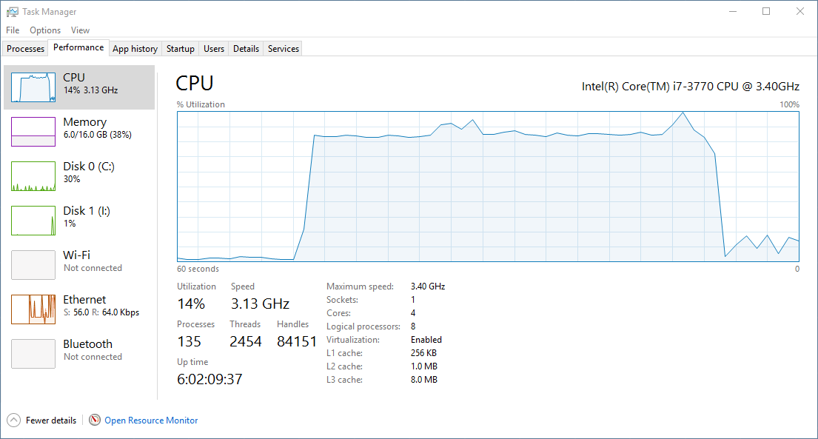
Pushing the Limits
class Spinner implements Runnable {
@Override
public void run() {
while(true);
}
}
Spinner sp = new Spinner();
for(int x=0;x<6;++x) {
Thread mgr = new Thread(sp);
mgr.start();
}
Streams of bytes … two ways (into your program and out of your program)
Disks, consoles, sockets, keyboards, printers
Know how to talk streams and you can talk to anything
Initialization (constructor) is different. Use is the same.
Notes:
Our last thread spent most of its time sleeping.
@1 Here the thread spins forever. The CPU is constantly working processing the check-true and jump-back-to-the-top.
@2 Here I create an object with a run method
@3 And put make a loop to start six
@4 Here is the task manager (home machine). I have 4 cores … 8 virtual CPUs. Six threads constantly spinning takes up nearly all the available CPU. When I stop them the usage returns to normal.
There are 2454 threads running now. What if I make it 2000? Or 4000? Eventually the computer gets sluggish and might even freeze up completely forcing a reboot. Give it a try on your own machine!
Let’s think about the memory footprint now. How many objects have I created?
@5 I created one Spinner object
I created SIX thread manager objects, each pointing to the same object. Perfectly OK. The threads all share the heap but have their own local variables and call stack.

Slide 9
The Thread (Controller) Object
Thread ta = new Thread(sp);
int pri = ta.getPriority();
ta.setPriority(25);
ta.setPriority(Thread.MIN_PRIORITY);
// MAX_PRIORITY, NORM_PRIORITY
boolean live = ta.isAlive();
ta.interrupt();
Thread me = Thread.currentThread();
Thread.dumpStack();
Thread.sleep(5_000);
ta.start();
ta.stop();
Streams of bytes … two ways (into your program and out of your program)
Disks, consoles, sockets, keyboards, printers
Know how to talk streams and you can talk to anything
Initialization (constructor) is different. Use is the same.
Notes:
Why not stop a thread?

Slide 10
Stopping a Thread
class Speaker implements Runnable {
boolean running;
@Override
public void run() {
running = true;
openDatabaseConnection();
while(running) {
System.out.println("Hello World");
Thread.sleep(2_000);
}
closeDatabaseConnection();
}
}
Speaker sp = new Speaker();
Thread t = new Thread(sp);
t.start();
Thread.sleep(3_000);
t.stop();
sp.running = false;
t.interrupt();
Streams of bytes … two ways (into your program and out of your program)
Disks, consoles, sockets, keyboards, printers
Know how to talk streams and you can talk to anything
Initialization (constructor) is different. Use is the same.

Slide 11
Stopping a Thread
class Speaker implements Runnable {
boolean running;
@Override
public void run() {
running = true;
openDatabaseConnection();
while(running) {
System.out.println("Hello World");
try {
Thread.sleep(2_000);
} catch (InterruptedException e) {
// ?
}
}
closeDatabaseConnection();
}
}
Speaker sp = new Speaker();
Thread t = new Thread(sp);
t.start();
Thread.sleep(30_000);
sp.running = false;
t.interrupt();
Streams of bytes … two ways (into your program and out of your program)
Disks, consoles, sockets, keyboards, printers
Know how to talk streams and you can talk to anything
Initialization (constructor) is different. Use is the same.

Slide 12

Tinkering
Write a program to print “Hello” in one thread and “World” in another thread.
The “Hello” should print once a second.
The “World” should print every other second.
Have “main” stop both of these threads after 60 seconds.

